Slide 1

Knock. Knock. Who’s there?
A message from the future
Notes:
Sometimes there are days I wish I could turn back time and undo some things to pretend they never happened. Almost like git rebase for time.
1927 a British astronomer called Arthur Eddington came up with a concept called “arrow of time”. In the concept he described the time as unidirectional or always flowing in one obvious direction. But we don’t have to be fancy astronomers to grasp the concept of time
We all understand quite early in our life’s that time is constantly flowing in one direction and there is no turning back. Except when we implement time based business requirements we have a tendency to look back in time and believe that’s the only way to go.
Today I will take you through a journey of time and explore how traditional approaches sometimes fail, what alternatives we can leverage and how we can use durable timeouts to predict the future.
But first I have some shocking news for you

Slide 2

Business logic tends
to be complicated
Notes:
(click)
Thanks Captain obvious for this piece of advise
(click)
Jokes aside when working with clients I see people end up making the same kinds of mistakes repeatedly or more accurately the symptoms are the same.
The way that people make mistakes is very different each time so most of it has to do with business logic, so with regards to business logic I think it's fair to say that all of us in our systems have some kind of complicated business logic. But I want to talk about a specific kind. The kind that involves both commands and queries.
So who is a part of their business logic: sometimes has to look up some additional data?

Slide 3
Hiding
Inconsistencies
Notes:
And it turns out that in that area that when you have your most complicated business logic, which often gives the business the greatest value. That's where we actually have consistency problems that are hiding.
And this is irrespective of whether you're using Command and Query Responsibility Segregation (CQRS) or not.
Even if you're using a fully synchronous end to end architecture talking to a fully transactional relational database. These things can bite you
A lot of times everybody's heard about this eventual consistency. You can go use it . Mongo web scale and all those kinds of things.
But a lot of organizations say, well, we'd rather Keep it safe and stay with the things that we know
I'm here to tell you is that even when you're using this safe architectural choices of doing everything synchronous even when you're using the safe technology choices like using SQL server, Oracle even then, sometimes you could end up with an inconsistent system.
These inconsistency problems get aggravated in multi user collaborative systems

Slide 4
Multi user collaboration
Notes:
The systems where lots of users are working in parallel have become more and more main stream
Users these days expect to be able to access their data, whenever they want and wherever they want
When you have a situation where you have users that are only operating on their own data. Life is actually pretty simple I call those types of systems that are multi single user systems.
They're kind of like a multi user system, but each user's kind of in their own little data and that's it.
It's when users are able to touch each others data that things start to get even more interesting. Unfortunately, when we look at not just the technologies that we're dealing with, but the programming practices and the paradigms a lot of them are based on that same object oriented thinking.
(next)

Slide 5
Multi user collaboration
Notes:
You write objects and you persist these objects in some kind of database and it works or at least it works on your machine pretty well. Then you put it in production in some kind of problems happen.
Usually the way that we address consistency concerns when we have multiple users operating on the same set of data is using things like optimistic concurrency
Who's heard of optimistic Concurrency?
So we got our traditional first one wins in last one wins concurrency where first one wins means first user that get in get their changes done last one has to redo their changes.
Sometimes this gets even more interesting when we jump into a user and themselves.
But first let me introduce a boring domain you probably already know a ton of

Slide 6
Frontend
Backend
Database
ASP.NET CORE
Front
Back
Storage
Orders
Read / Write
HTTP
Notes:
Demo 1
I’m going to use a retail domain because retail and orders is something most people are familiar with. I know, boring but I will follow that for now and try to keep you awake
Switch to code

Slide 7
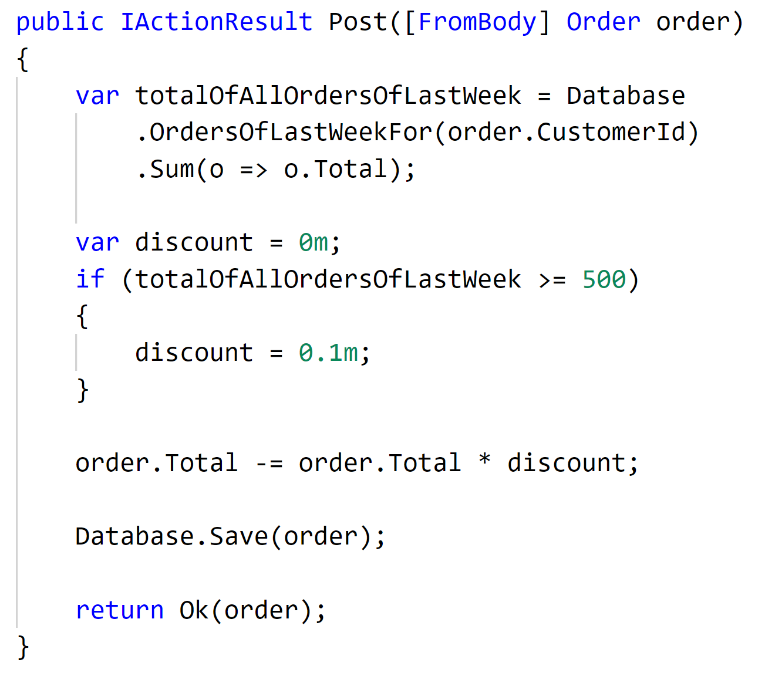
Notes:
The order controller implements some business logic. It is not really complicated business logic but we got a new business requirement that says as a part of processing a new order we want to decide under which conditions a customer is going to be getting a discount.
The customer that is submitting this order in the past week did more than $500 euros Swiss Francs Norwegian kroner Swedish kroner Danish kroner whatever your currency of choice then they get a discount. And if not, they don’t.
Your average developer looks at the requirement implements this code doesn't really think twice checks that it works
The area where things become a little bit tricky is what happens if it’s 2 or more users because the customer in essence is an account and we can have multiple users from the same account buying stuff on the same account. So we have two or more users at the same time, both of them are submitting an order.
Let’s see it in action. Run the demo

Slide 8
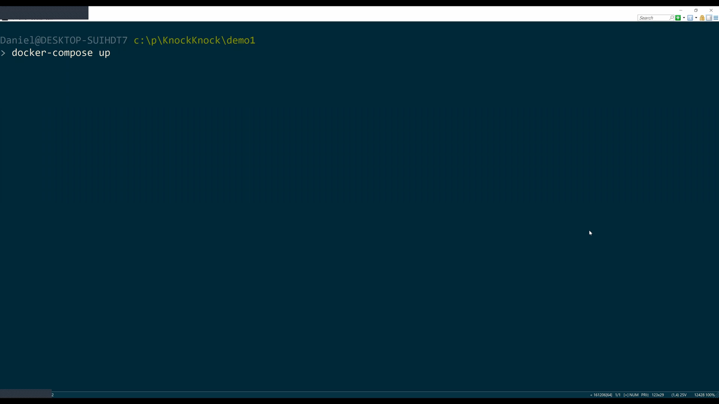
Notes:
Alright so imagine 2 threads going through that logic at the same time, where the last week of orders was $300.
Each of them is submitting a new $300 order.
Both of the logic goes down to the database. Both threads go to the database take a look at all of the existing orders.
Oh. No, we've only got $300 worth of orders. Sorry no discount

Slide 9
And then the customer walks into your office
Notes:
For one of the order the customer didn’t get a discount. You can imagine this gets worse the more concurrent requests we get from the same customer. Where if these users just made their requests a couple of seconds apart, then one of them would have gotten a discount.

Slide 10

Notes:
Now that's not a very nice thing to do when you think about it, I mean, ultimately, we are penalizing our users.
For this type of behavior for purchasing too quickly.
So in short we can say

Slide 11
Concurrency and latency in collaborative
domains can lead to incorrect application of business rules even in safe architectures
Notes:
Inconsistencies have a real impact on end-users
How we ended up here to begin with? So this idea about processing these types of things in real time before that, we had the good old solutions. For any kind of data crunching we wrote our good old

Slide 12
Batch Jobs
Batch Jobs
Notes:
Batch jobs
These BatchJobs where the beasts waiting to be activated by a scheduler once a day (mostly during the night).
Once the lever was yanked of the big batch crunching machine the machine started humming and crunching tons of tons of data in the database.
Essentially reading a lot of information, applying some business rule and then writing something into the database back. What those batch jobs did essentially is aggregating data and putting the aggregated state into domain entities

Slide 13
Frontend
Backend
Database
ASP.NET CORE
Front
Back
Storage
Orders
Read / Write
HTTP
Batch
Notes:
Demo 2
Here's a code that might look like something like that,
Switch to code

Slide 14
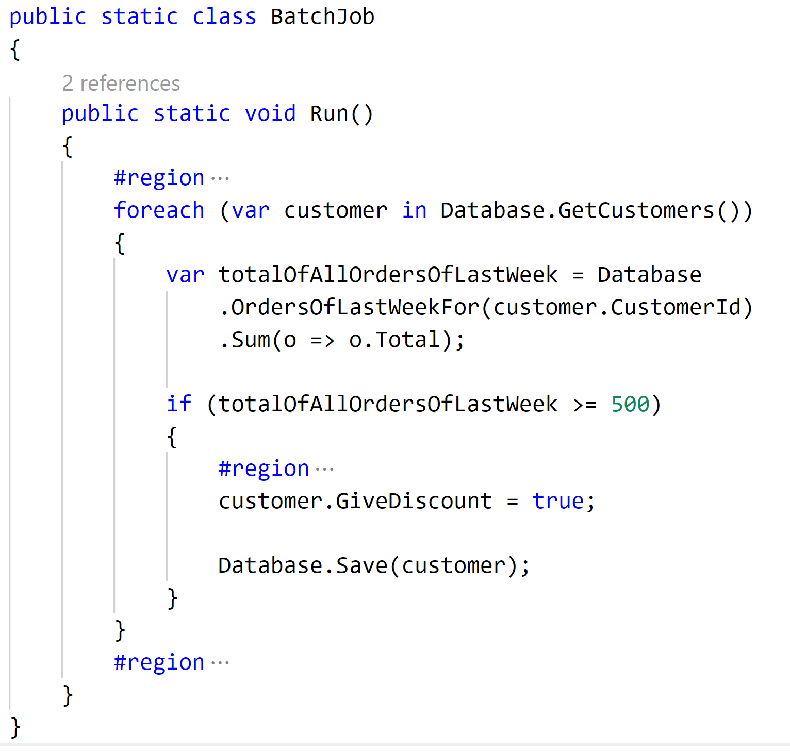
Notes:
So what we have here is a batch job that is invoked in a nightly batch and what it is doing is fairly simple. It looks up all the orders for all customers. Sums them up and if the total of all the orders from Last week is greater than 500 it sets a flag on the customer so that the customer gets a discount. And of course you can imagine there would be also some sort of logic in there that resets the flag. So essentially we are touching every single customer and order whenever this batch job runs.
Let’s see how the controller now looks like

Slide 15
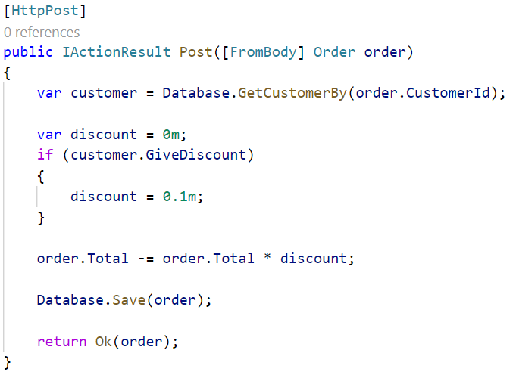
Notes:
And then in terms of the order logic to order logic is simpler. Now we just check that give discounts this is a customer dot give discount.
So this is how we used to approach these types of logic.
Anytime you needed to do some big historical data crunching you read from the datastore and roll up the business intent into a Boolean or some other aggregate value and then in the real time environment you just check those values.
The problem with this is that we have created now a far worse business problem.
Again if two users are coming in, and this time it is not clicking the submit button at the same time, it is clicking the button on the same day! And if they are two users from the same account submitting an order we are ultimately saying no sorry if you want to get a discount come back tomorrow. You realize how ridiculous that sound if you are a customer, saying no if you make your purchased today. You don't get a discount.
But if you come back tomorrow. I'll give you a discount. I’m sure our customers and users won’t like that.
What’s even worse is that with batch jobs the more successful we are with our business the longer the runtime of the jobs becomes. Our business success is the batch jobs undoing
So it's understandable why businesses all over the world are moving away from these type of batch jobs. It doesn't workout that well at least with regards to the discounts or in general time based business requirements.

Slide 16
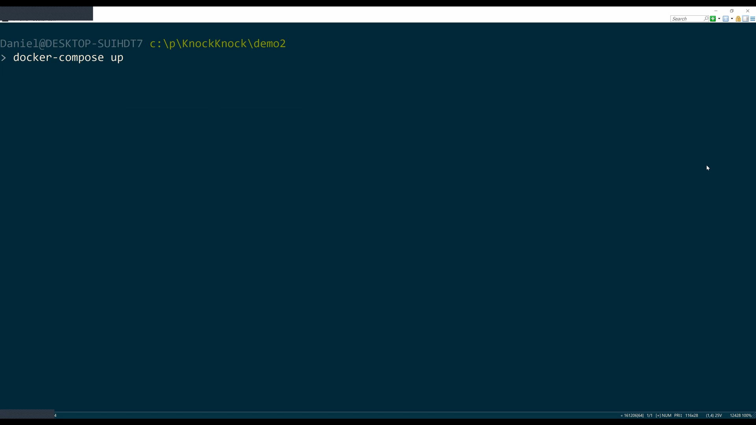
Notes:
Submit button at the same day (or interval of batch job)
Come back tomorrow if you want discount (ridiculous)
More successful we are the longer the batch job takes
Business success is the batch job undoing
- Moving away from batch jobs, doesn’t work at least not for time based business requirements

Slide 17
Batch Jobs increase the window of consistency problems
Batch Jobs for time based business rules
are the worst enemy for growth
Notes:
In recap from the demo we can say that
Batch Jobs increase the window of concurrency problems
Batch Jobs for time based business rules are the worst enemy for growth
The bigger issue is that once again we have a consistency problem. And in order to solve it we need to

Slide 18

Rethink time
Notes:
A lot of our traditional domain models in a parallel collaborative type of world are defective by design.
Thing is we can do better.We can do a whole lot better, but it requires us to think about software and about requirements in a slightly different way.
The hinge in dealing with software in parallel type of software is exactly that it's that concept of time. It's rethinking the arrow of time and how we program with it.
So the traditional requirement that we said was Alright.

Slide 19
t
1 week
Sum(o => o.Total)
Notes:
We've got this stream of orders that are coming into our system. And whenever we get an order we look back in time, 7 days or whatever the requirement is to sum up.
The total value of orders in that period of time and if the value is greater than 500 then they get a discount and we mentioned the problem was if we have 2 things happening at the same time, we can end up with an inconsistent value.
We can achieve the same result instead of looking backwards in time looking forwards in time.
Which seems a little bit unusual?
How can you predict the future thing is you can’t predict the future but you can!
Fold the future into your programming now and let me explain how you do that logically so when we get an order ultimately what we're interested in is the last 7 day Total instead of calculating that at the time of the order.
We can turn that around and say actually let's introduce that concept into our domain itself.
A customer has a 7 day running total of orders because ultimately that's what the business is telling us it’s talking about the last 7 days? Once again we got workarounds and not requirements from our business

Slide 20
t
WeekTotal
WeekTotal
+= o.Total
1 week
-= o.Total
+= o.Total
1 week
-= o.Total
+= o.Total
1 week
-= o.Total
Notes:
What we're doing is we're just making that explicit so when we get $300 order?
The 7 day running total is $300 but that needs to be decrement, in 7 days in the future.
In essence, we want to send data to ourselves 7 days from now saying, You know you need to decrement the 7 day running total 7 days from now.
And as we get this stream of orders that are coming in and we say OK now we increment it by $300 now. And we throw information into the future, and saying decrement it by another $300 then.
And as we keep on going you aggregate the data that we need so that we have a current running total.
That's telling us OK. Now it's $300.
Now it’s $600 etc. And as we catch up to ourselves in time.
Then we need to have that kind of wake up call saying Hey look. It's been 7 days since order number one say, Oh, OK, then what I need to do. Is to decrement it down to 300 OK?
It's been 7 it's been 7 days since order number 2 Alright.
Let's decrement that one down as well.
The difference here is that like I said instead of looking back in time. We look forward in time.
So as we're modeling this as new orders are coming in. We're doing. That same type of behavior over and over and over again, so that when we finally arrive at a specific order.
(next)

Slide 21
t
WeekTotal
WeekTotal
+= o.Total
1 week
-= o.Total
+= o.Total
1 week
-= o.Total
+= o.Total
1 week
-= o.Total
Notes:
We're not actually doing a query. We're not doing historical look up. But rather we've folded the history into our current state. But we've done that in a highly consistent way.
The reason that we've done it in a highly consistent way is that what we've done is we've in essence created an upside down anti-batch job.
So remember the code that we have with our batch job where we said no over here, we're going to have a customer.
That has some sort of give discount equals true value.
We rolled up some state and we put it in the customer. We're doing the same thing here.
We're rolling up some state and putting it in the customer. The important thing is that when we're dealing with a
customer or something like that? What we can say is well. Now we have a specific entity that has specific data.
This is one row. In the database. Databases can guarantee us full transactional consistency at the level of a single row.
Others if we have 2 things that are happening at the same time, one of them wants to submit a new order and another one is dealing with a timeout.
Then ultimately that bid is going to lock on that single row.
That, in essence is the trick of an aggregate root to design your logic in such a way that all transactions are touching just a single row a single entity.
However, in terms of programming this requires something that we don't really have…

Slide 22

Program time
Notes:
A way to program time. An you know system threading timer. Not such a good idea is it.
The problem with those types of in memory timers is that if our machine crashes. Well, it won't remember that, it needs to decrement the value in 7 days.
So we need a highly reliable durable transactional way of dealing with time, so that no matter what happens in our system: We won't lose that information.
Once we have all of this kind of stuff then will be in a situation where you can say all right now, we can build real aggregate roots.
Timeouts are becoming the part of your business state and should be treated the same ways as data in your SQL table data. That’s why we need durability.
One way of achieving that is to leverage our durable scheduler that we might already have in place from the good old days of executing batch jobs

Slide 23
Frontend
Backend
Database
ASP.NET CORE
Front
Back
Storage
Orders
Read / Write
HTTP
Scheduler
Notes:
Demo 3
So instead of executing batch jobs we use the scheduler to schedule order total amount decreases into the future

Slide 24
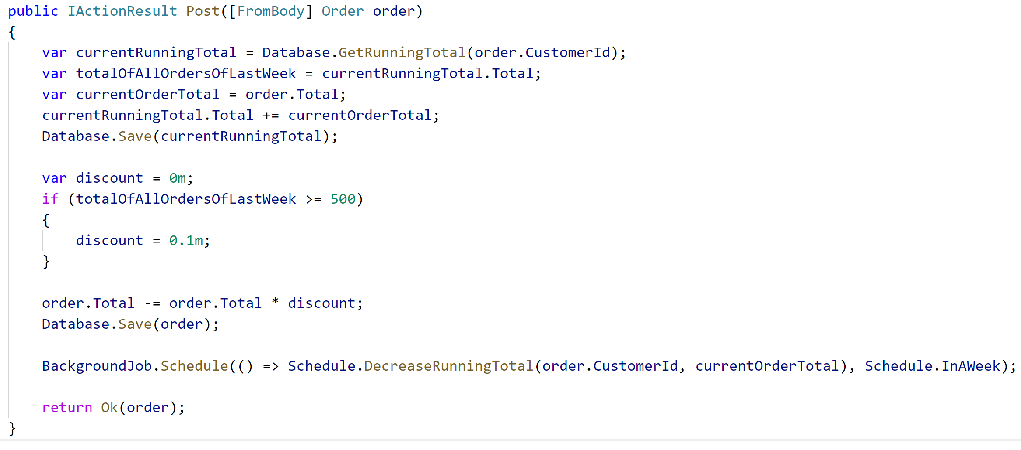
Notes:
So whenever an order is sent into our controller we get the running total for the customer and save that into the database. I know you’d probably have some unit of work with change tracking and not multiple Save calls but this is just for illustration purposes.
Then you apply the discount if necessary and use the scheduler to schedule a running total decrease with the currentOrderTotal for the current customer ID one week into the future.
Let’s have a look at the DecreaseRunningTotal
Switch to that.
Come back here. When the scheduled timeout is due at the same time the current order total gets decreased we have two possible failure scenarios due to last one wins. Either the controller is first and the scheduled timeout is first which is nicely handled by hangfire or the controller operation fails. When this happens client side retries in the HTTP pipeline are required. But let me explain more in the slides

Slide 25
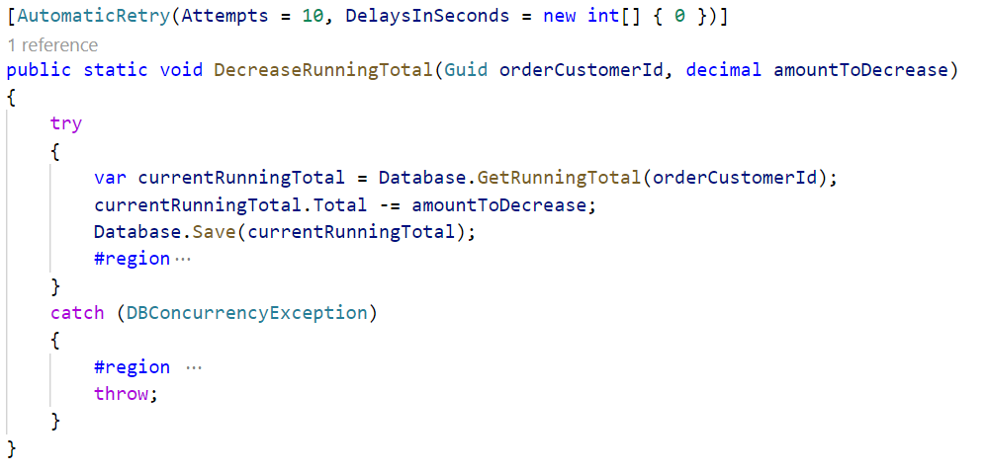
Notes:
So when the timeout is due we get the running total for the customer and decrease it by the total order amount and save it transactionally back to the database.
We can also see that we have to wrap this code in a try catch or at least have a scheduler that supports multiple retry attempts (luckily hangfire does that). This is due to the fact that concurrent operations for the same customer id can happen at any time due to timeouts being due or orders coming into the system. When that happens multi-version concurrency control kicks in and we have to retry. So let’s get back to the controller and see how this affects the controller.

Slide 26
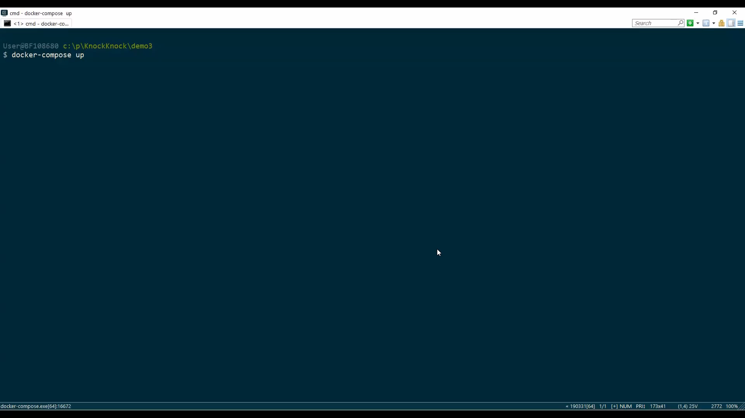

Slide 27
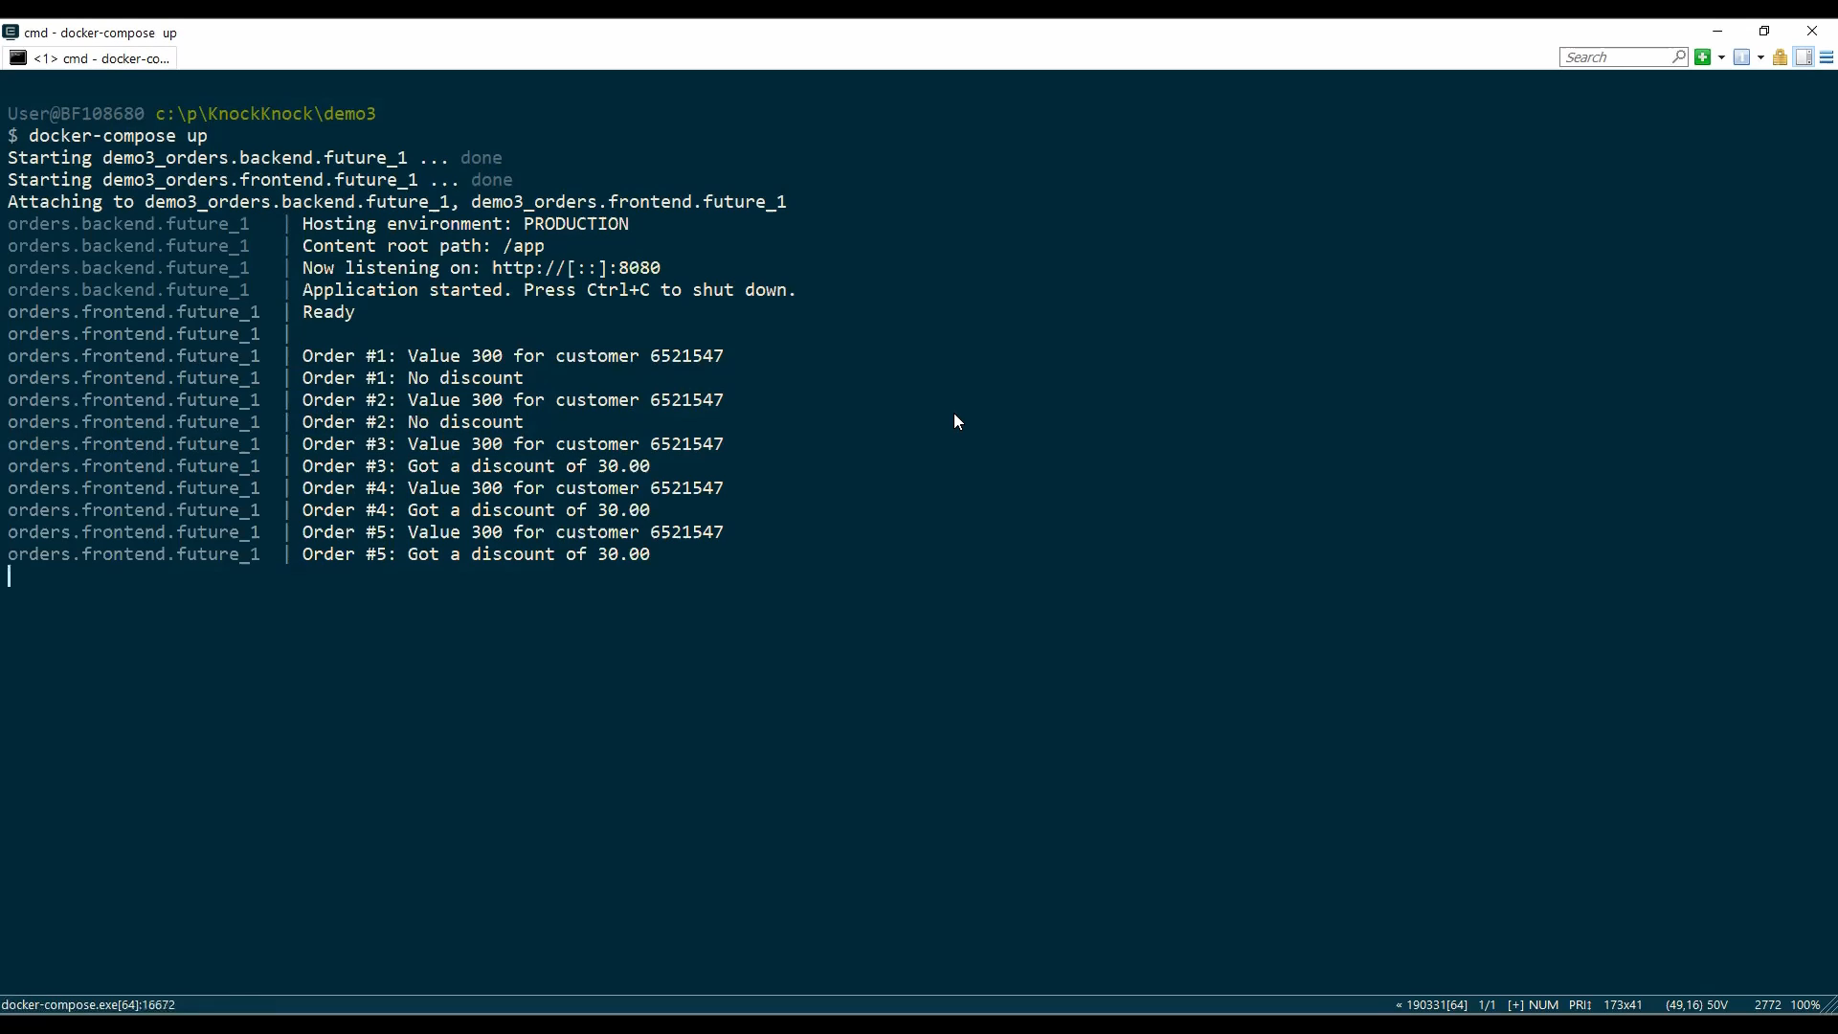

Slide 28
Durable scheduling introduces reliability on the server side
Notes:
As we could see in the demo while this works nicely and also durably saves running total decreases in hangfire the more orders we get the more we end up overloading an infrastructure which is not really built for this type of activity.
Furthermore because we are directly modifying the running total in the transaction of the controller it is possible that we end up with concurrency conflicts caused either from the customer ordering a lot of stuff or the running total being decreased while we are trying to add the current total of an order to the running total. Hangfire in our example luckily has built in retries so the server side is mostly fine. But the story is different on the server side

Slide 29
Resilient HTTP introduces some reliability
but doesn’t survive restarts
Notes:
Because of the concurrent modification of the running total we are forced to add retry patterns to the client calls as well as to the scheduler infrastructure. Given that the scheduler infrastructure is durable that’s fine but the HTTP client calls are not really durable. So we effectively end up building a poor mans queuing infrastructure on top of HTTP in memory with retries.
Because with RPC all of the queues are effectively in memory!

Slide 30
Client side retries help to resolve transient failures but increase the latency
Notes:
A lot of stuff waiting to be processed. With durable messaging messages are stored on disk, and we have more and cheaper disks than memory.
Because of the RPC call chain when ever the latency between the DB and the backend was slow or there was a concurrent update on a row those effects rippled through the callstack to the issuer of the call, which is the front-end.
Furthermore on every request from the front-end a new database transaction was created and when many operations were pending those transactions sometimes rolled back or slowed down the order processing
The temporal and special coupling is high. The latency of the storage layer directly influenced the customer facing latency.

Slide 31
Orders might be lost when clients give up on retries
Notes:
Orders got lest when the client of the request stopped retrying
Orders could not be throttled and worst the actual order intent was difficult to find in HTTP callstack exception logs
To make the next step on our programming evolution towards the future we need a different perspective on the problem.
So we need a highly reliable durable transactional way of dealing with time, so that no matter what happens in our system. We won't lose that information.

Slide 32
Orders are ideal to
Fire & forget
from the frontend perspective
Notes:
The domain of order processing is a good domain to apply messaging because every order can be answered with “thank you we will shortly process the order”
So instead of doing a regular HTTP call we can pack the parameters of the HTTP call (headers and bodies) into a message and send it to the backends queue for processing. Let’s call this a SubmitOrder command. With that approach the command becomes the consistency and transaction boundary and queries are decoupled from commands and each individual message can fail and retry without affecting the frontend
But messaging is not enough to implement business processes. For things like discounts we need a stateful actor that builds up the running total for a customer and coordinates whether the orders should be processed with a discount or not. That’s when Sagas can come in handy
(and usually business processes are more complex than just applying a discount and coordination)

Slide 33
Sagas
Notes:
It's not going to look like your average domain model. Let me tell you that. It's not going to have one to many relationships what
this is going to be building on is a pattern that in service we called a saga. But this comes from the saga ideas ultimately taking what we were talking about here, saying what we have over here is a long running process.
We need a transitionally consistent stateful long running process that can be managed by time
Tthe saga pattern was Discovered documented in by the database community in the 80’s around the good old mainframes as they were dealing with what's known as Long live transactions.
So they were trying to address the same kind of issues, but more from a data up perspective. What we're now looking at it from a domain driven design perspective is a behavior down.

Slide 34
Sagas
Notes:
So it's not a by the book saga definition, but it follows a lot of those same principles and within services.
To program these types of things because, like, I said number one well time isn't something that we have a very good way of programming, either in net or in Java or in Ruby or in python. It requires a little bit of infrastructure and also requires us to deal with the issue of well, the consistency. What happens if I have a time out being processed at the same time as a new order is coming in.
We need to make sure that those locks hold up and that's why they have to go on the same entity alright. So when dealing with this not going to spend too much time talking about the infrastructure a lot of the ways that sagas behave with regards to an infrastructure perspective are documented, and you can see it online. I want to talk more about the behavioral modeling side of it.

Slide 35
Frontend
Backend
SQL Database
Back
Front
DiscountPolicy
Storage
ProcessOrder
Order
RabbitMQ
Queue
Notes:
Demo 4
So this time instead of sending the orders over HTTP we send the orders into the input queue of the backend. When the SubmitOrder command is submitted by the frontend it gets processed by the discount policy. The discount policy applies the discount to the order and sends a ProcessOrder command to itself with the discounted order.
I’m using RabbitMQ and Sql Server on Linux for the demo. Everything I’ll show is done using NServiceBus. For the sake of transparency I would like to mention again that I work for Particular Software the makers of NServiceBus. You don’t have to use NServiceBus. For example Rebus, MassTransit and others have similar concepts built in.
But let’s dive into the code

Slide 36
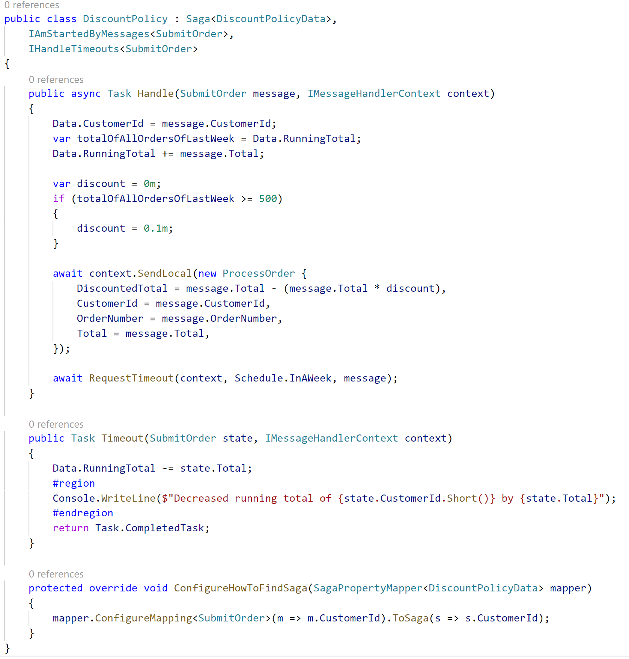
Notes:
Let’s zoom in

Slide 37
Notes:
The saga policy data stores the order running total. IAmStartedByMessages means a new discount policy is started per customer id. When two sagas for the same customer id are started concurrently the infrastructure takes care of resolving the consistency conflict by rolling one back and retry.
The ProcessOrder message will not go out when the saga is rolled back so will not go out the timeout.
When the saga is completed ProcessOrder command will go out to the ProcessOrderHandler and a durable timeout is scheduled to be due in one week. We can directly reuse the SubmitOrder command because it nicely encapsulates all we need to know to decrease the order total in 7 days.
The mapping is required to tell the infrastructure which message property defines the saga uniqueness.

Slide 38
Notes:
When the saga is completed ProcessOrder command will go out to the ProcessOrderHandler and a durable timeout is scheduled to be due in one week. We can directly reuse the SubmitOrder command because it nicely encapsulates all we need to know to decrease the order total in 7 days.
The mapping is required to tell the infrastructure which message property defines the saga uniqueness.

Slide 39
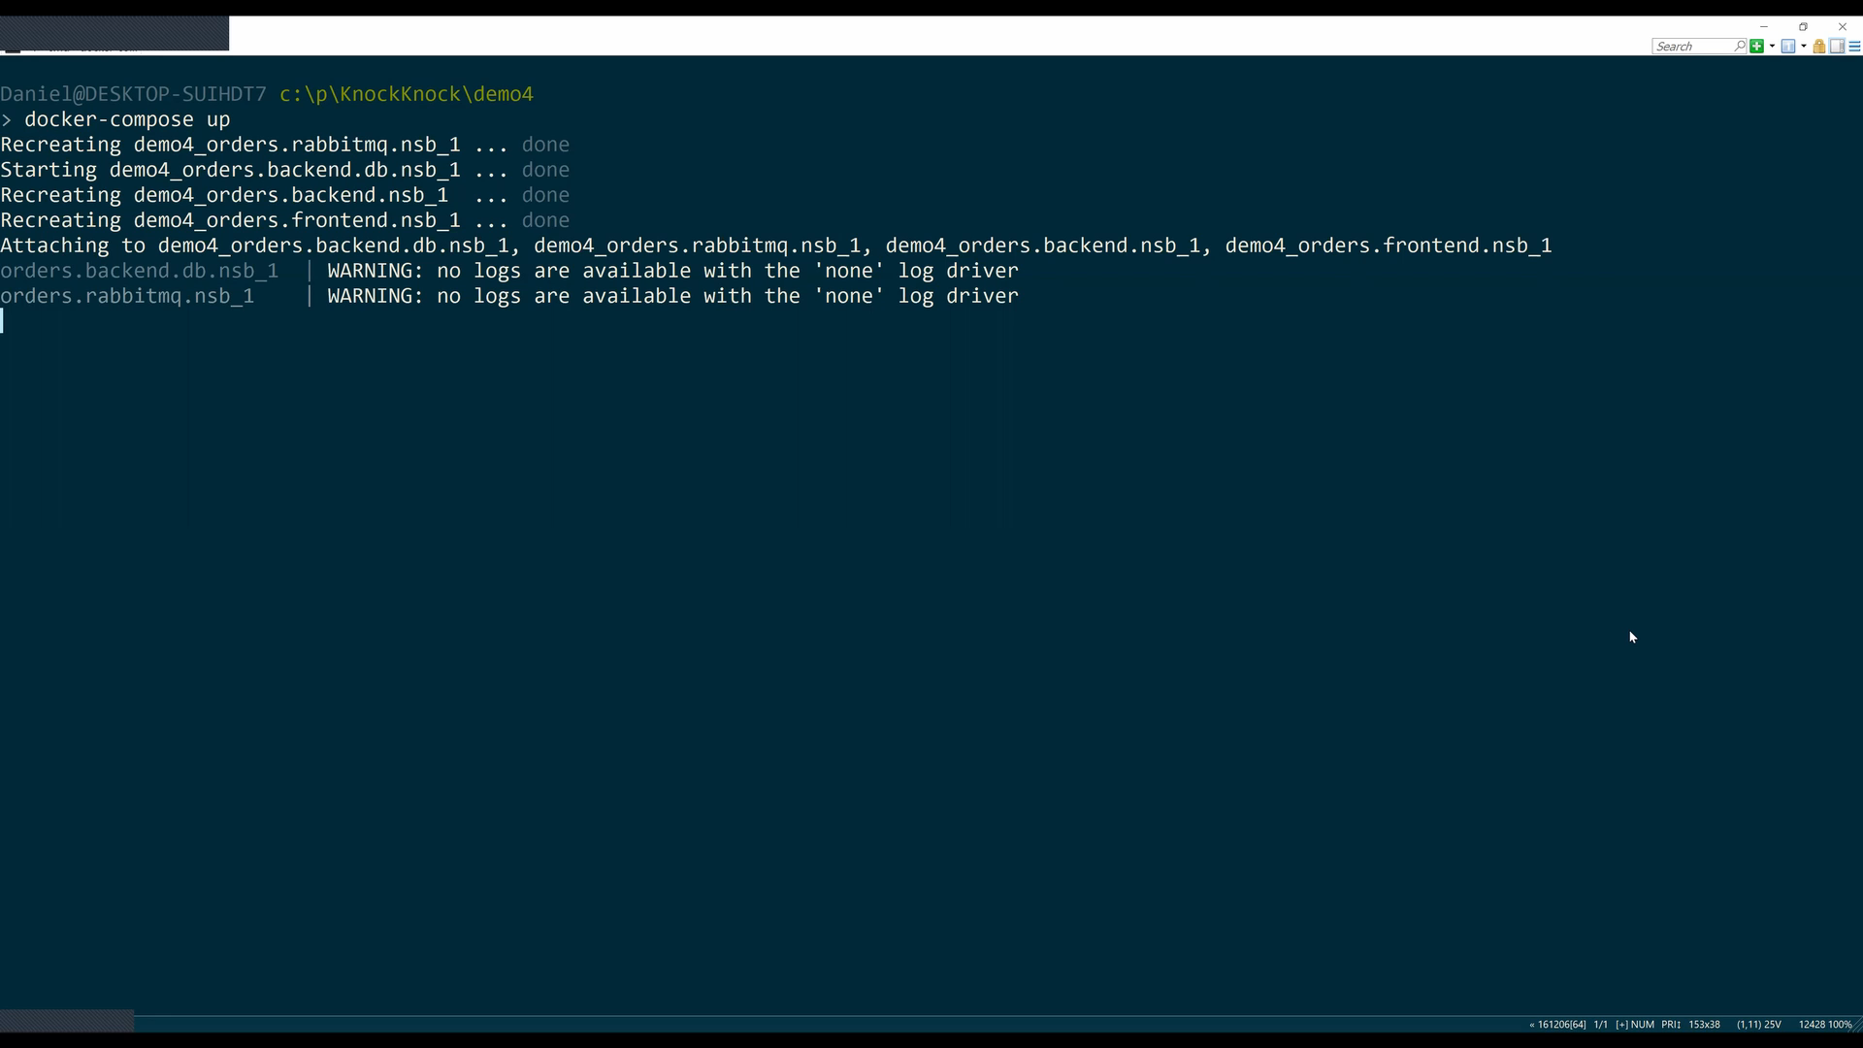

Slide 40
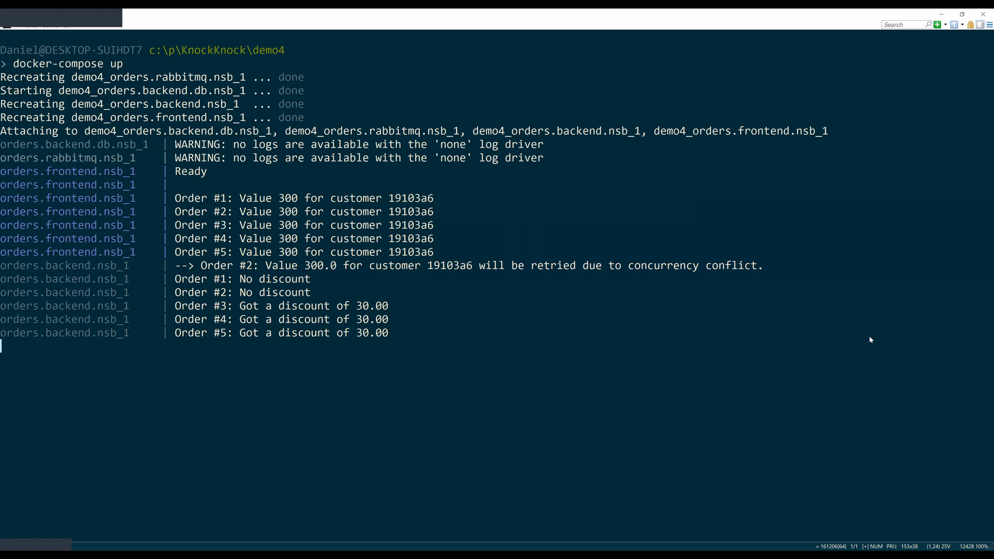

Slide 41
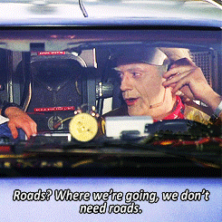
Notes:
For Time and messages being able to become an actor the message broker requires support for delayed delivery. For example Azure Service Bus has a feature built into the broker itself which allows to defer messages into the future by setting the ScheduledEnqueueTimeUtc or use ScheduleMessageAsync. AmazonSQS has built in scheduling only up to 15min while RabbitMQ for example doesn’t provide delayed delivery out of the box. Let’s have a quick look how NServiceBus addressed those short comings
This is just a little detour into delayed delivery. Don’t worry if you don’t understand everything and rest assured if you use a higher level framework like NServiceBus these things are reliably taken care off and you don’t need to think about it anymore.

Slide 42
AmazonSQS

Slide 43
600 s
2,800 s
900
(1,900)
900
(1,000)
900
(100)
100 s
Notes:
AmazonSQS
When a delayed message is sent, the delay duration is calculated. If it's less than or equal to 900 seconds, the message is sent directly to the destination input queue with the DelaySeconds message attribute set to the delay duration.
If the delay duration is greater than 900 seconds, then the message is sent to the destination's FIFO (FIFO queues are used to deduplicate messages in case of network outtages in a time window of 5 min) queue with the NServiceBus.AmazonSQS.DelaySeconds custom message attribute set to the delay duration. When the message is received from the FIFO queue after 900 seconds, the remaining delay duration is calculated. If it's less than or equal to 900 seconds, the message is forwarded to the destination input queue with the DelaySeconds message attribute set to the remaining delay duration. Otherwise, the message is sent back to the FIFO queue with an updated custom message attribute set to the remaining delay duration.
The transport uses timestamps from the broker to avoid clock skew, but a discrepancy between broker and endpoint clocks still has potential to cause inaccurate delay calculation.

Slide 44
RabbitMQ

Slide 45
42₁₀ seconds
42 seconds
101010₂ seconds
Notes:
When a message needs to be delayed, the value of the desired delay is first converted to seconds. The binary representation of this value is used as part of the routing key when the message is sent to the delay-level exchanges

Slide 46
(42₁₀)
32 s
1
16 s
0
8 s
1
4 s
0
2 s
1
1 s
0
Notes:
A delay level is created by declaring a topic exchange that is bound to a queue with a routing key of 1, and to the exchange corresponding to level - 1 with a routing key of 0. The queue for the delay level is declared with an x-message-ttl value corresponding to 2^level seconds. The queue is also declared with an x-dead-letter-exchange value corresponding to the level - 1 exchange, so that when a message in the queue expires, it will be routed to the level - 1 exchange.
The delay levels are connected in this manner, from highest (27) to lowest (0). Each delay level's routing key adds wildcards as needed so that each routing key is looking at the portion of the message's routing key that corresponds to its delay level.

Slide 47
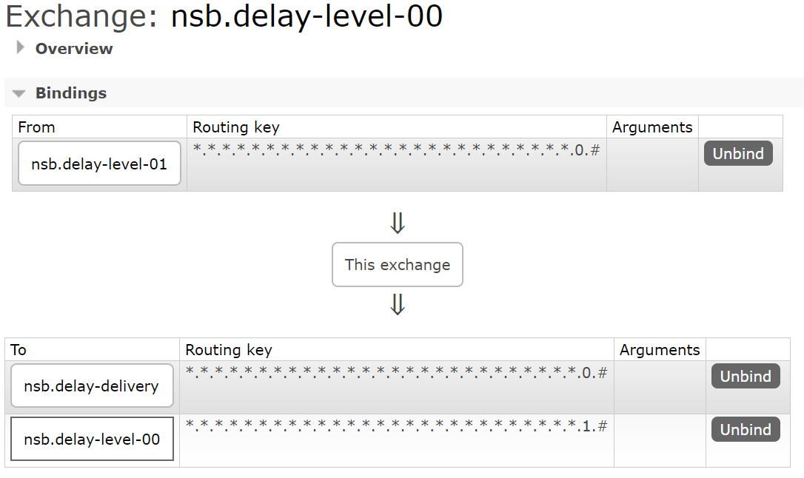
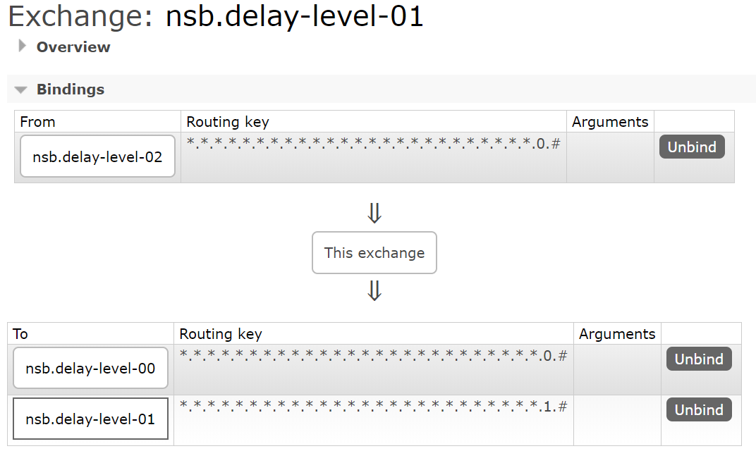
N.N.N.N.N.N.N.N.N.N.N.N.N.N.N.N.N.N.N.N.N.N.N.N.N.N.N.N.destination
Notes:
As an example, a delay of 10 seconds (1010 in binary) on a message bound for the destination queue is encoded with a routing key of:
0.0.0.0.0.0.0.0.0.0.0.0.0.0.0.0.0.0.0.0.0.0.0.0.1.0.1.0.destination

Slide 48
28 queues
2²⁸ seconds
268,435,456 seconds
8.5 years
Notes:
25 > 1 year
26 even
27 safe
28 even
32 > 136 years

Slide 49


Slide 50
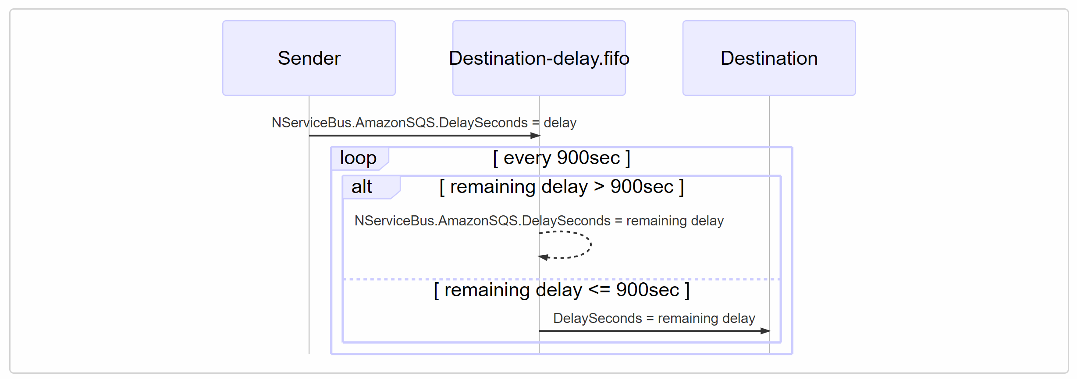
docs.particular.net/transports/sqs/delayed-delivery

Slide 51
docs.particular.net/transports/rabbitmq/delayed-delivery
N.N.N.N.N.N.N.N.N.N.N.N.N.N.N.N.N.N.N.N.N.N.N.N.N.N.N.N.destination

Slide 52
Messaging introduces reliability
Notes:
Messages introduce reliability because they capture the business intent and encapsulate the intent in a business transaction that can be retried or put aside until the more permant problem is solved

Slide 53
Retries resolve consistency issues automatically
Notes:
For transient failures like DBTimeouts or temporary locks retries can resolve those issues without having an impact on the end-users.

Slide 54
Sagas on top of a robust middleware allow to focus on the business logic and stay reactive
Notes:
Sagas are nice way of coding the business policies and folding the time into the code as we saw. For domains where occasional conflicts occur they are very suitable and solve many of your business problems. But they are not a golden hammer.

Slide 55
For ultra high contention domains different approaches might be necessary
Notes:
For example for high contention domains like inventory management for highly anticipated books like Harry Potter sagas might not be a good fit because it would lead to multiple users reading and writing a single inventory row
Everyone wants to buy the new Harry Potter. We have some transaction. First, we check if there's sufficient inventory for the amount someone wants to purchase. If there's enough, we update the table and set the quantity to a minus b.
When someone buys the item we update the record, the problem here with the example of popular book is that suddenly we have locks on the the same row
What happens to messages in the queues? They also get locked
What happens if someone then wants to buy another book? Well we might have already used all the database connections up by the high amount of contention
The problem with these approaches is that up until black friday everything works perfectly The problem with this type of logic is that you won't find out until your site goes down. Everything goes well, and then you get featured on Oprah. And the marketing guys go ballistic, because of this. And then the site goes down.

Slide 56
Ask the collaborative domain question first
Notes:
That's why we ask the collaborative domain question first, because collaborative domains can take your site down
It doesn't matter how many layers or microservices you have when they end up being locked on the same record

Slide 57
Business consistency rarely ever needs to be addressed with technical solutions
Notes:
The issue is that this isn’t a technical issue, it’s the business! The business should accept a negative inventory! Instead of having this as an issue, design business processes to have alternate paths when we’re out of stock. For example say “sorry” or “here’s a coupon” or “wait a little bit longer” Business can’t have high contention and a locking business process.

Slide 58
Favor simplicity over complex design wherever you can
Notes:
Only after having had that conversation with the business I suggest to look at technical solutions for those high contention domains where Sagas with message and Multi-version concurrency control is not enough. Find a simple solution like using an atomic counter. Popular databases have atomic counter or CRDT support. But don’t go atomic counters, CRDTS, CQRS the shit out of your systems. Apply technical and simple solutions where they make sense.

Slide 59
Thanks
Notes:
Thanks

Slide 60

go.particular.net/dnd19-parsec

Slide 61
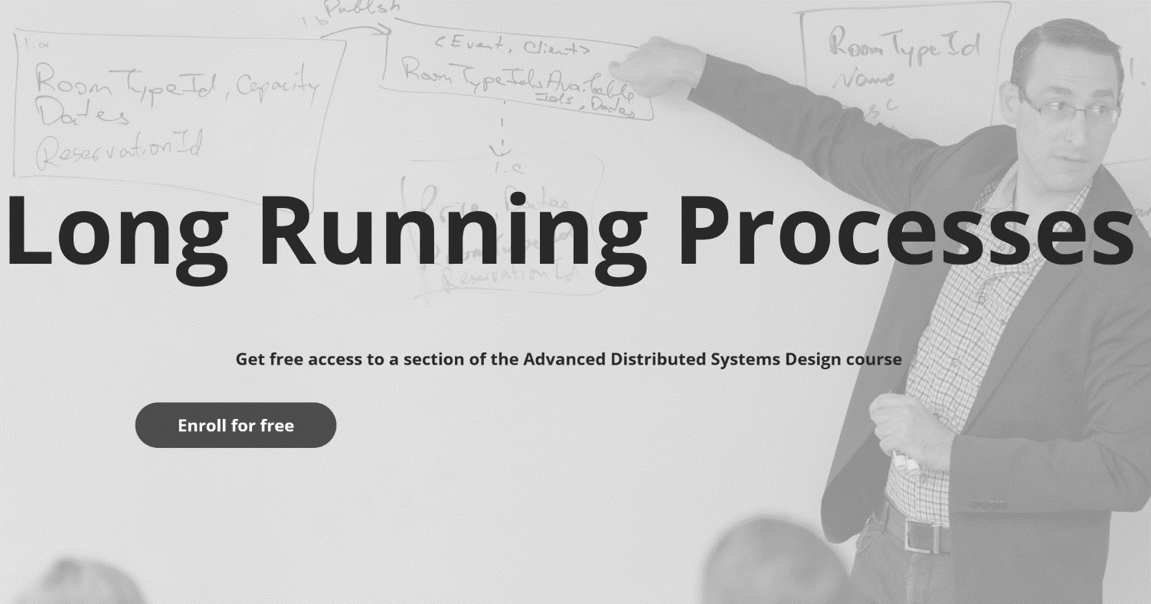
go.particular.net/dnd19-knock-knock

Slide 62
Slides, Links…
github.com/danielmarbach/KnockKnock

Slide 63
Q & A

Slide 64

Software Engineer
Enthusiastic Software Engineer
Microsoft MVP
@danielmarbach
particular.net/blog
planetgeek.ch
Notes:
I’m Daniel, Solution Engineer…
I live in central Switzerland. If you want to know more about me listen to episode 77 of developer on fire
You can reach me on twitter under @danielmarbach
I blog on the particular blog and on my personal blog
I’m the lead behind the asyncification of NServiceBus and the ecosystem around it
I regularly contribute back ideas and code changes to asyncify the .NET OSS libraries and frameworks out there. So far I contributed to Entity Framework, RabbitMQ, Marten, MassTransit, Quartz.NET and many more

Slide 65
Thanks
Notes:
Thank you very much for listening and see you next time

